Slide 1
O R CHAR D KN O B COLLABOR ATIVE
“ C O M PA S S I O N AT E C O L L A B O R AT I O N ”

Slide 2
HISTORY
Battle of Orchard Knob (November 23, 1863)
Minor American Civil War battle that saw the first fighting in General Grant's plan to drive away the Confederate army besieging Chattanooga. That army's main defensive position ran along Missionary Ridge, east of Chattanooga.
Orchard Knob Reservation
Orchard Knob is located in the Chattanooga Unit of Chickamauga and Chattanooga National Military Park. It is an anomaly in what is now central Chattanooga—a tall hill sticking out like a sore thumb in an otherwise flat surrounding. However, during the Civil War it was far away from the city limits. From the top you can see in all directions, so in addition to manning the high points of Lookout Mountain and Missionary Ridge, the Confederates posted 634 men on and around Orchard Knob.
Wildflowers
Orchard Knob represents one of the final remnants of these habitats left in Chattanooga. Today, it is a refuge for more than 200 species of plants, including seven that are rare in the state of Tennessee. One of the rarest plants found here is Clematis Fremontii, also known as Fremont’s leather flower. This species is found at only two sites in Tennessee, and only three east of the Mississippi River.

Slide 3
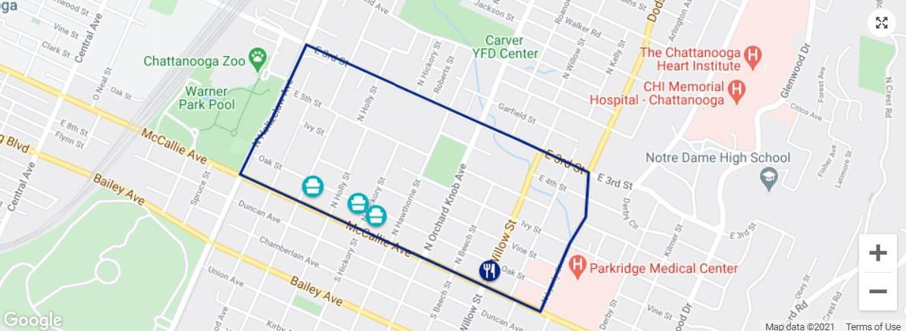
BACKGROUND

Slide 4
ORCHARD KNOB COLLABORATIVE (OKC)
Roots
OKC began in November 2019 through the partnership of Orchard Knob Neighborhood Association, Glass House Collective, Parkridge Health System, Habitat for Humanity of Greater Chattanooga, Chattanooga Design Studio, and United Way of Greater Chattanooga
Mission
to improve the health and wellbeing of the community by addressing the social
determinants of health
Vision
To be a vibrant and thriving community that is healthy, safe, and economically viable

Slide 5
ORCHARD KNOB COLLABORATIVE: MISSION, VISION, & GOALS
The Mission: to improve the health and well being of the community by addressing
the social determinants of health.
The Vision: a vibrant and thriving community that is healthy, safe, and economically
viable.
The investments of the Orchard Knob Collaborative will seek to provide improved:
Physical infrastructure. Social Infrastructure. Healthy Living.

Slide 6
COLLABORATIVE ANCHOR INSTITUTIONS
Representatives from core organizations facilitate discussion and guide decision making processes
Representatives from supporting organizations provide resources and insight for programmatic structures and development

Slide 7
COLLABORATIVE PLAN
In order to accomplish the vision & goals of the Collaborative, the core partners will focus their efforts on three phases of improvement.
Physical Infrastructure
Social Infrastructure
Healthy Living
Phase I includes:
improving the quality and safety of homes and community landscapes
reducing risks associated with unhealthy and unsafe living conditions
Phase II includes:
providing access to available resources
alleviate social need stressors, such as food insecurity, safety, expense affordability, etc.
Phase III involves:
strategic community development
provide sustainable solutions for current and future residents

Slide 8
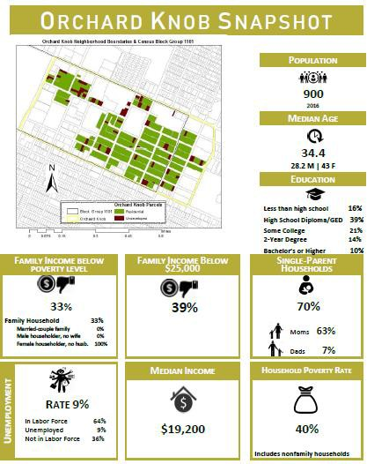
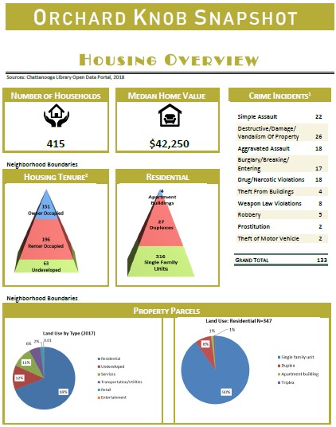
ORCHARD KNOB DEMOGRAPHICS

Slide 9
WHY IS HEALTHCARE THE FRAMEWORK?
P E R C E N T A G E S A R E F O R O K C Z I P , N A T I O N A L P E R C E N T A G E S A R E I N P A R E N T HE S E S
Preventative dental visits – 43%
(68%)
Asthma – 12% (8%)
Cancer – 5% (4%)
COPD – 11% (6%)
Diabetes – 19% (13%)
Obesity – 40% (42%)
Smoking – 30% (14%)
Poor mental health – 18% (20%)
Uninsured people – 25% (9%)
Infant mortality (county) - 15 per 100,000 (6/100k nationally) of Black mothers compared to 6 per 100,000 of White mothers
Homicides (county) – 43 deaths per 100,000 (5 deaths per 100,000 nationally) compared to 4 deaths per 100,000

Slide 10
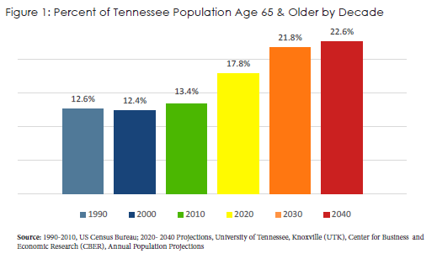
A STATEWIDE
ISSUE
Nearly 230,000 senior owner households are low-income.
The number of cost-burdened seniors is projected to increase by 2030 to almost 350,000 households statewide and to more than 385,000 households by 2040.
Source: Tennessee Housing Development Agency

Slide 11
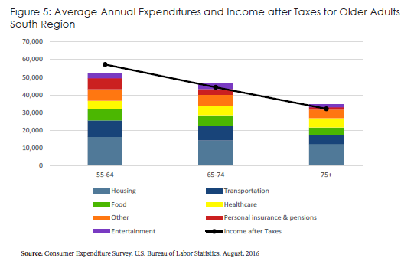
A STATEWIDE
ISSUE
The largest expense category for senior households is housing and related expenses, which does not include any home modification associated costs.
Transportation, food, and healthcare are the next most significant category expenses. Because seniors receive a fixed income, exorbitant housing costs create a barrier to afford other livelihood expenses such as healthy food options and pharmacy costs.
Source: Tennessee Housing Development Agency

Slide 12
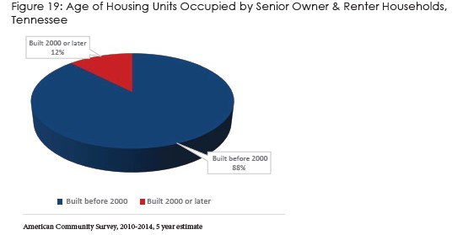
A STATEWIDE
ISSUE
88% of older Tennesseans live in homes built before 1980.
Homes built prior to 2000 are five times more likely to need accessibility modifications, and aging housing stock often needs critical repairs.
Source: Tennessee Housing Development Agency

Slide 13
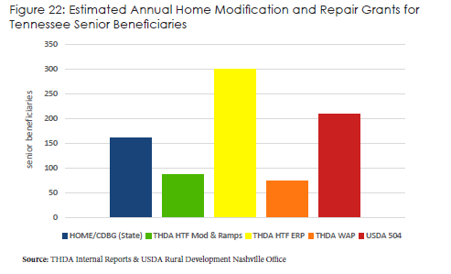
A STATEWIDE
ISSUE
An estimate of less than 1,000 seniors in TN benefited from home modification or repair grants/ loans last year, not including local grant programs, privately funded grants, or volunteer programs.
Source: Tennessee Housing Development Agency

Slide 14
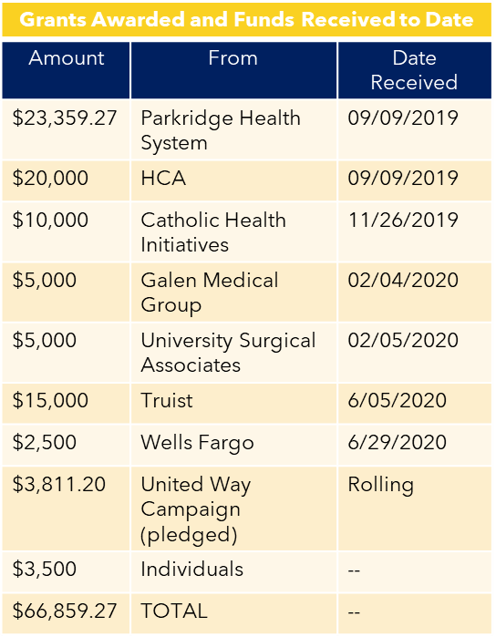
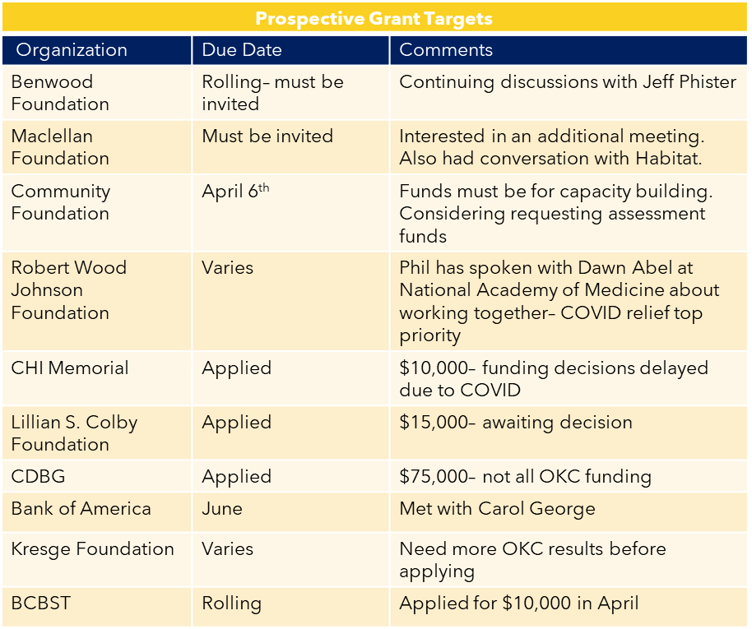
1ST ROUND OF FUNDRAISING
Note: Based on current home assessments, the critical work each home needs has trended to range between $10,000 - $15,000. This work includes but is not limited to: Roof repair; Bathroom renovation; Accessibility improvements

Slide 15
2ND ROUND OF FUNDRAISING
Grants Awarded & Funds Received To Date - 2021
Amount | From | Date Received
$10,000 | Parkridge Health System | 03/11/2021
$10,000 | HCA | 10/07/2021
$50,000 | Partners for Places | 10/05/2021
Prospective Grant Targets - Applied For 2021
Amount | Organization | Due Date
$608,625 | TVA | 9/30/2021
$231,871 | TANF | 10/15/2021
Note: Based on current home assessments, the critical work each home needs has trended to range between $10,000 - $15,000. This work includes but is not limited to: Roof repair; Bathroom renovation; Accessibility improvements

Slide 16
G OA L 1 :
P H Y S I C A L
I N F R A S T R U C T U R E

Slide 17
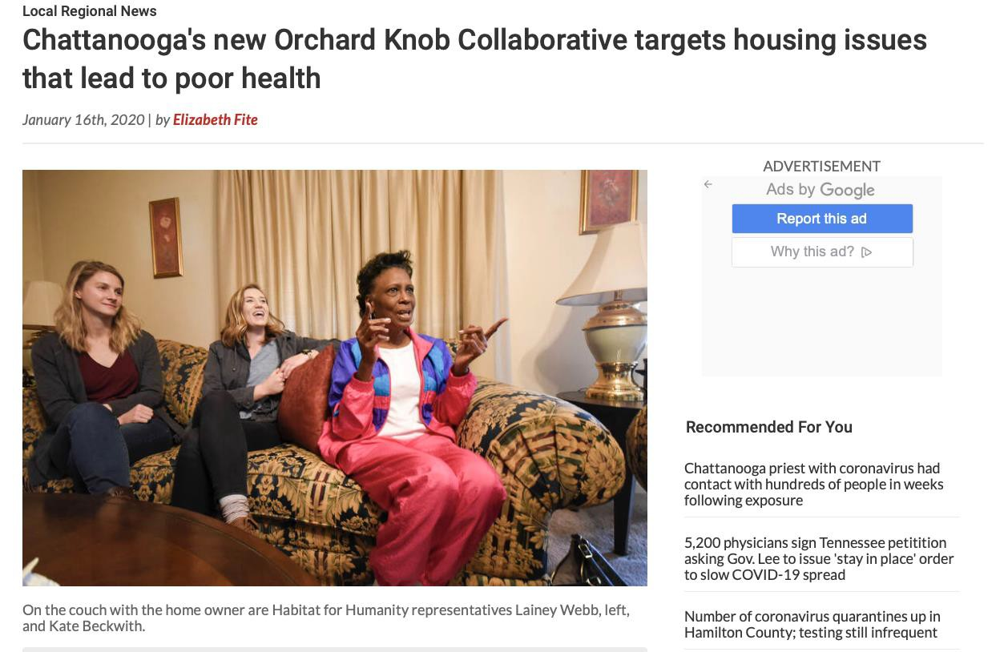
CONNECT TO PURPOSE
First Homeowner to receive home restoration, Zandra Strickland

Slide 18
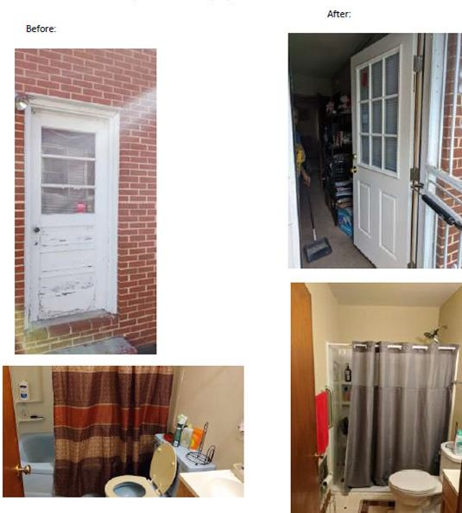
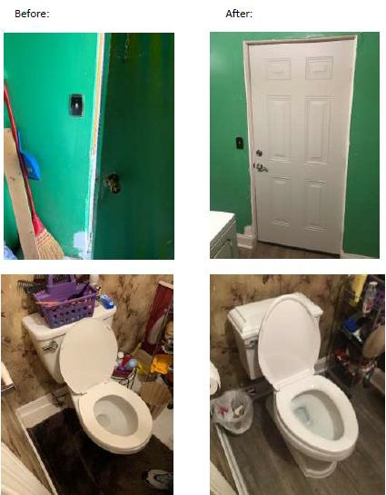
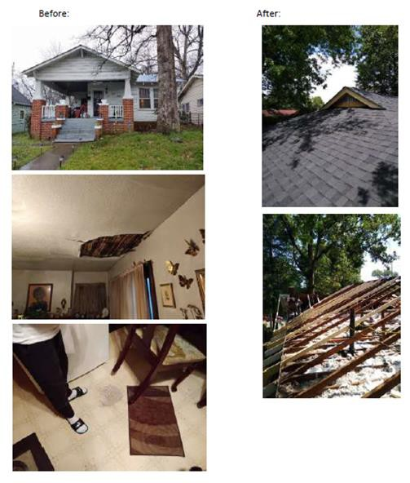
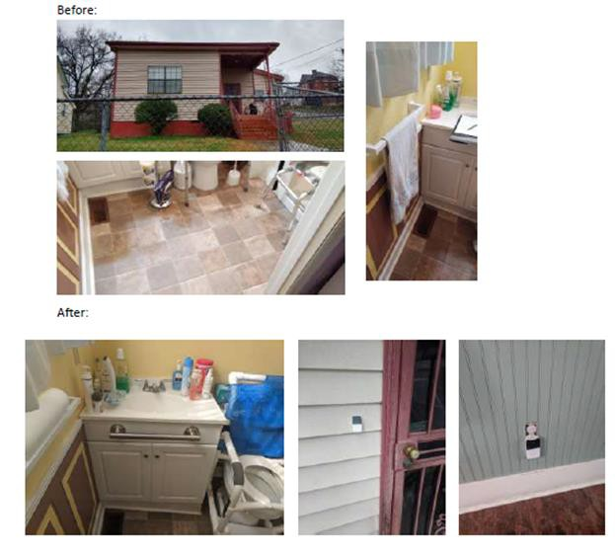
HOME
RESTORATIONS
5 homes
3 on 5th St.
2 on Ivy St..
Total spend: $64,435

Slide 19
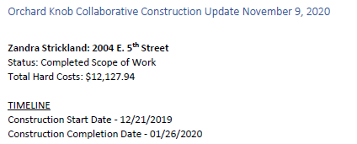
HOME RESTORATION PROJECT- HOME 1
Private

Slide 20
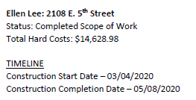
HOME RESTORATION PROJECT- HOME 2
Private

Slide 21
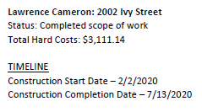
HOME RESTORATION PROJECT- HOME 3
Private

Slide 22
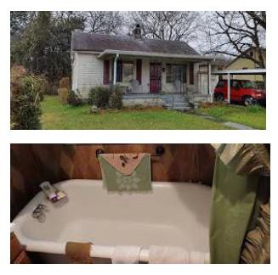
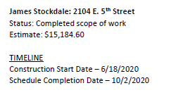
HOME RESTORATION PROJECT- HOME 4
Private

Slide 23
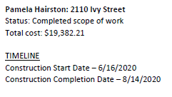
HOME RESTORATION PROJECT- HOME 5
Private

Slide 24
HOME RESTORATION PROJECTS – PHASE 2
5 more homes awarded for home restoration
In phase 2, the collaborative is focusing on exterior improvements, specifically fencing, mailboxes, landscaping, porch restoration, exterior painting and lighting.

Slide 25
G OA L S 2 & 3 :
S O C I A L
I N F R A S T R U C T U R E & H E A L T H Y L I V I N G

Slide 26
A M U LT I - A G E N C Y P L A N
T O C O O R D I N AT E
R E S O U R C E A L LO C AT I O N
Parkridge Cardiac Rehab Conversion
to OKC workout center.
Parkridge classroom converted to OKC teaching kitchen.
YMCA’s Rx to good health program.
Green Space’s Asthma Program.
Purpose Point Health now open.
Direct admission process now in
process.
University of Tennessee Architectural students participated with residents of Orchard Knob to “re-imagine” the area.

Slide 27
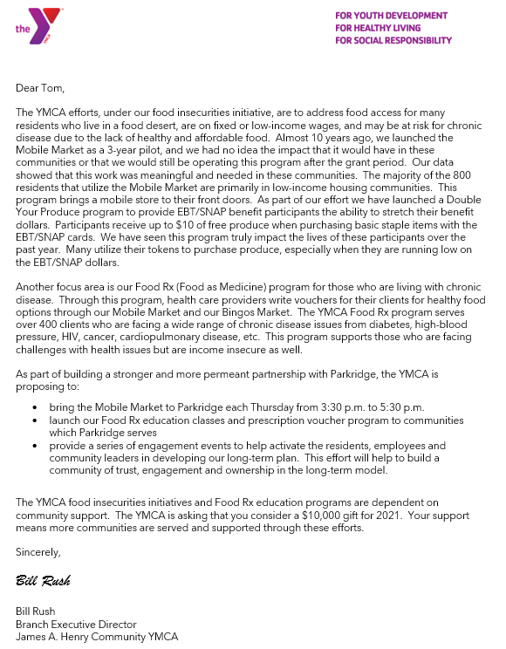
THE
START TO END THE FOOD
DESERT

Slide 28
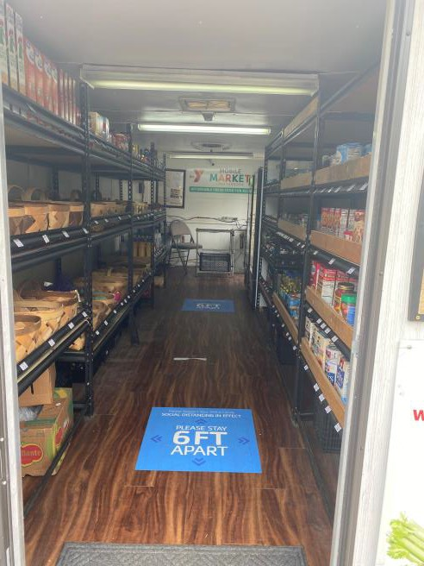
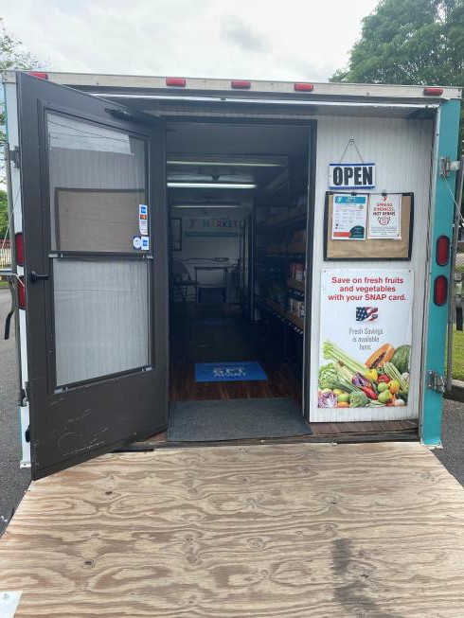
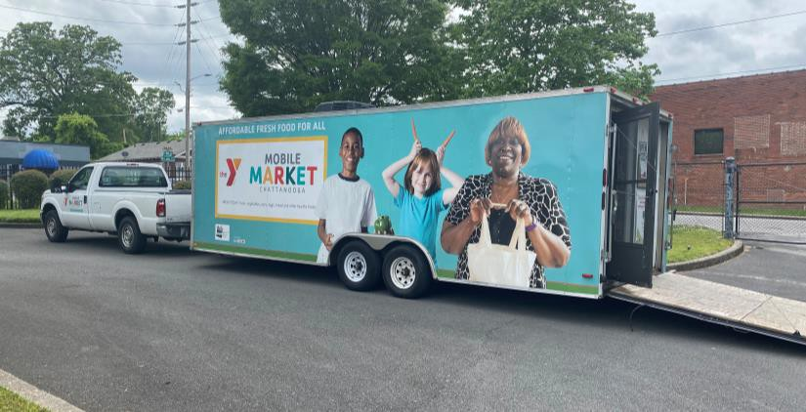
THE START
TO END THE
FOOD
DESERT

Slide 29
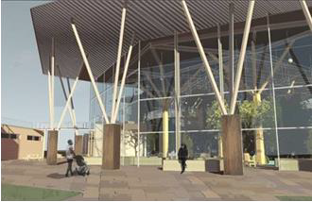
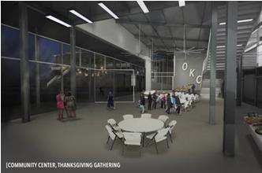
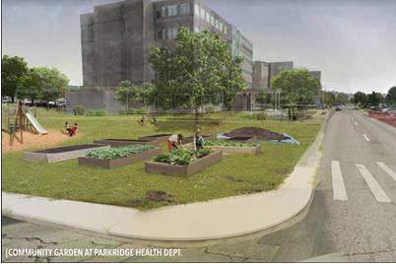
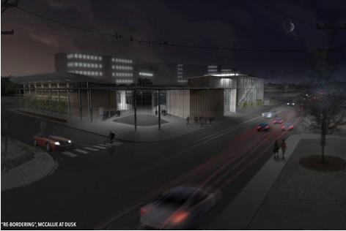
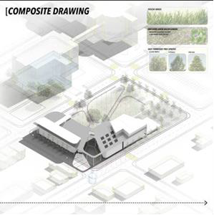
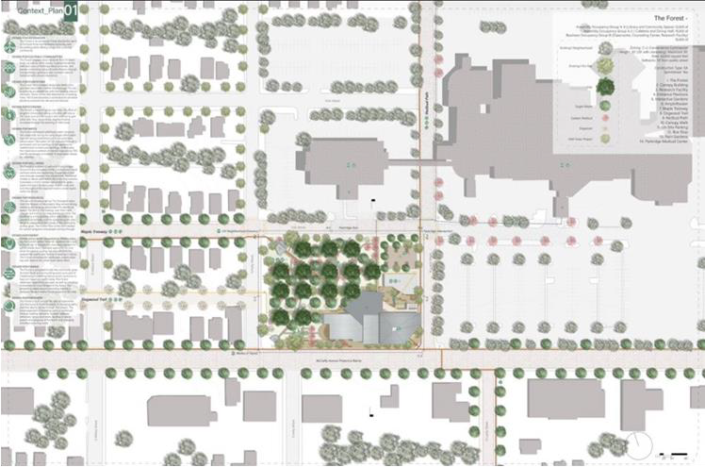
THE FUTURE ENVISIONED

Slide 30
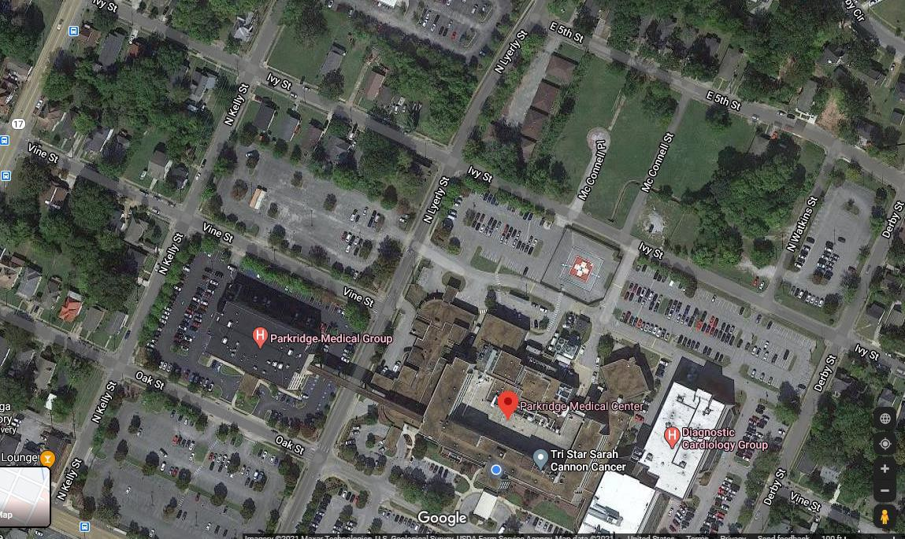
S O C I A L I N F R A S T R U C T U R E
& H E A LT H L I V I N G P R OJ E C T S
The largest project in this phase for improving healthy living and social infrastructure will be constructing a community playground on Parkridge Medical Center’s campus.
A location has already been identified and is outlined below in blue.
This is an “all community hands on deck” project

Slide 31
SOCIAL INFRASTRUCTURE & HEALTH LIVING PROJECTS
The collaborative will continue focusing on Ivy St. as a starting point for general neighborhood projects. Upcoming projects are listed below.
Additional street lighting
Add ground/walk path lighting
Tree planting – on track to start planting in Winter 2021
Replacing old neighborhood entry/exit signs with newer signage and updated logo
Replacing street sign toppers with bigger toppers and updated logo

Slide 32
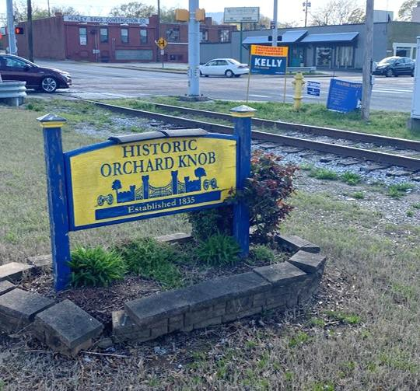
ENTRY AND
EXIT SIGNS
OKC will be working with the Orchard Knob Association on a new logo to use for the entry and exit signs into and out of the neighborhood. We will be installing newer and bigger street signs. Model sign will be at the intersection of McCallie and N. Kelley

Slide 33
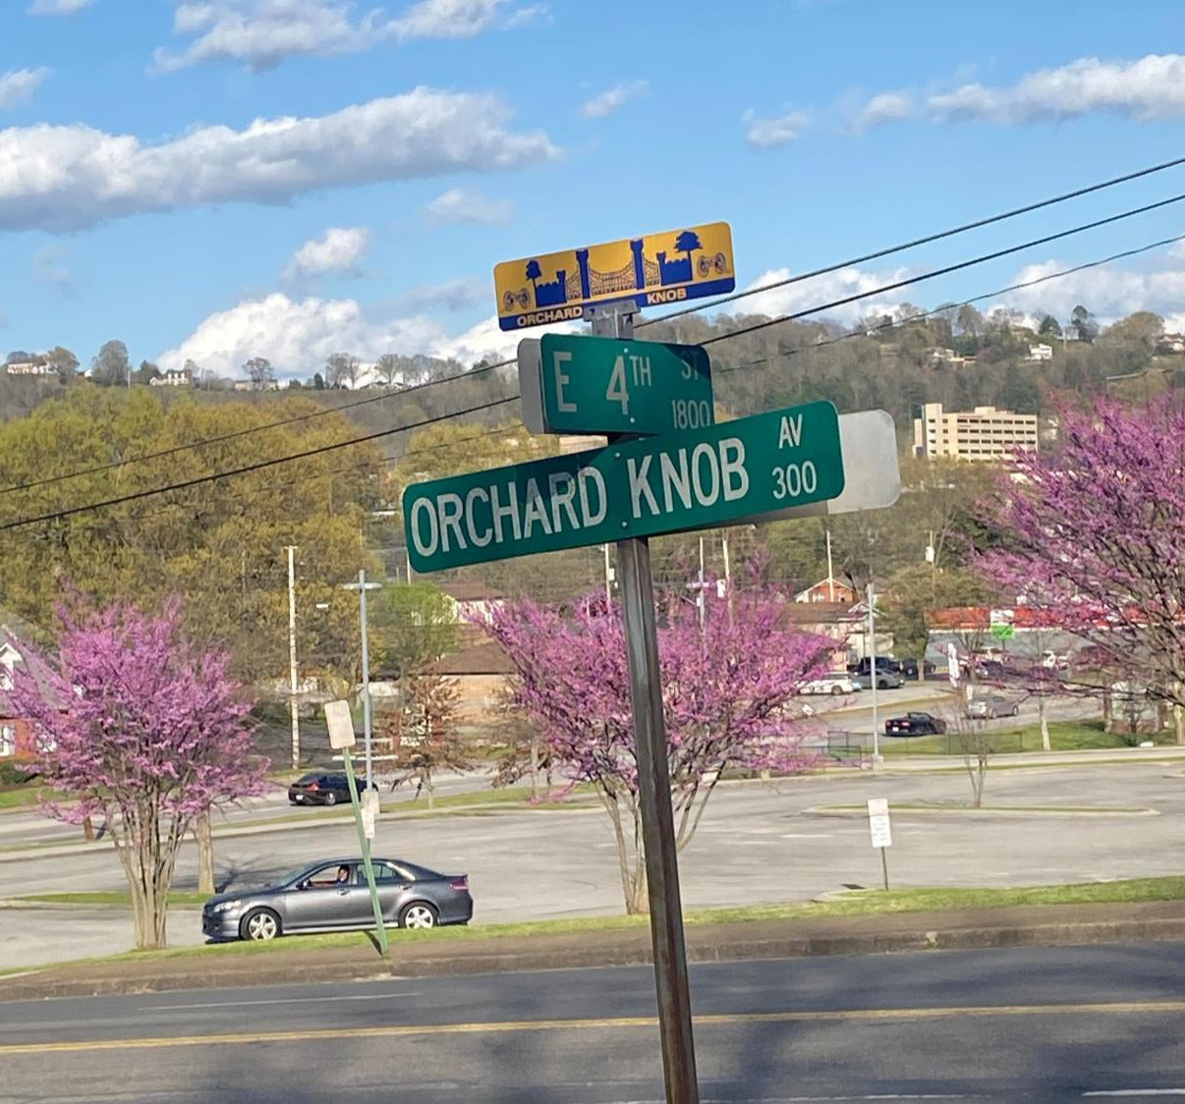
NEW STREET
SIGN TOPPERS
Continued from the entry and exit signage, OKC will also be working with the neighborhood association on a newer and more visible design for the street toppers.

Slide 34
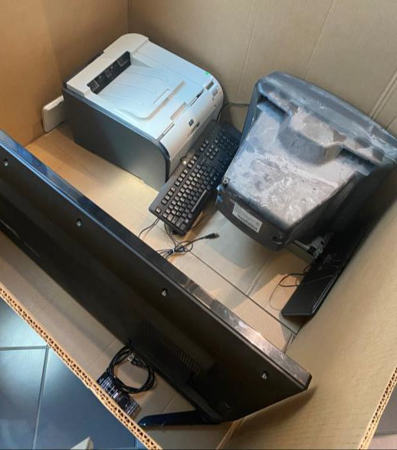
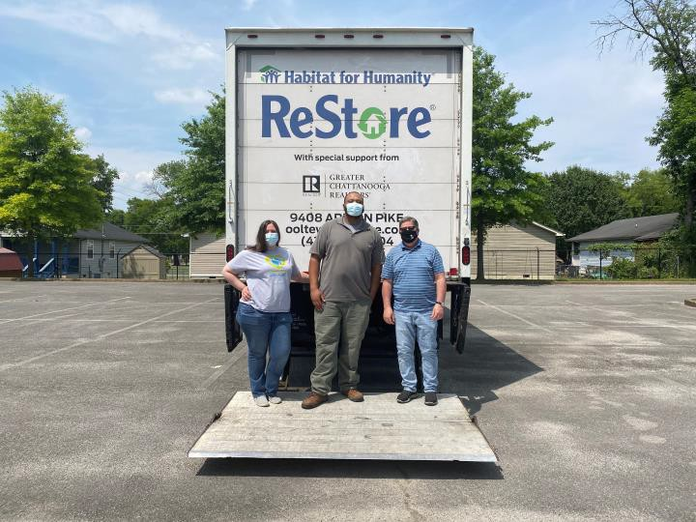
CURB AND
YARD APPEAL
Continuing the theme related to fencing, OKC will work on exterior home improvements including fixing porches, refresh painting, and landscaping, (mainly working with Habitat for Humanity)
We conducted a community clean up the week of May
24. During this week, we accepted old furniture, cars,
electronics, etc. as well as offering a means of disposal altogether to help with neighborhood.
Cost: $350

Slide 35
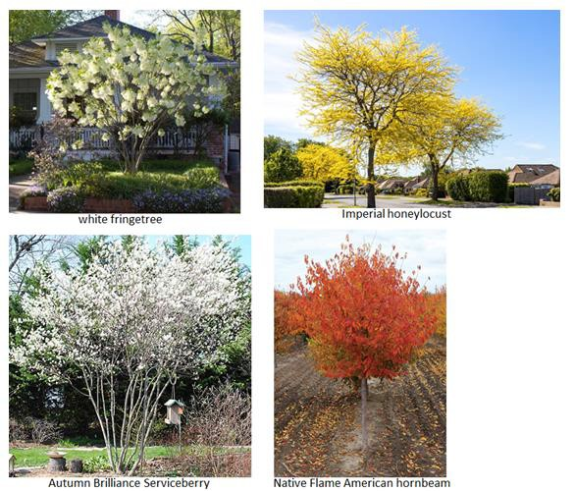
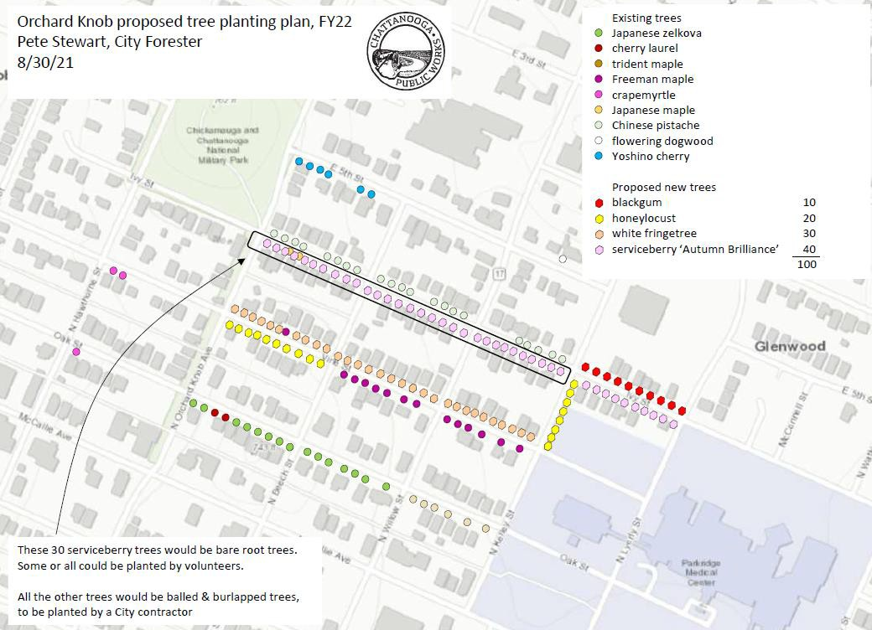
I M P R OV I N G A I R Q U A L I T Y
To improve the air quality, OKC, led by green│spaces, has partnered with the City of Chattanooga to purchase and plant more trees in Orchard Knob.
The tree planning plan is pictured.
Cost: $18,140
Target Date: January 2022

Slide 36
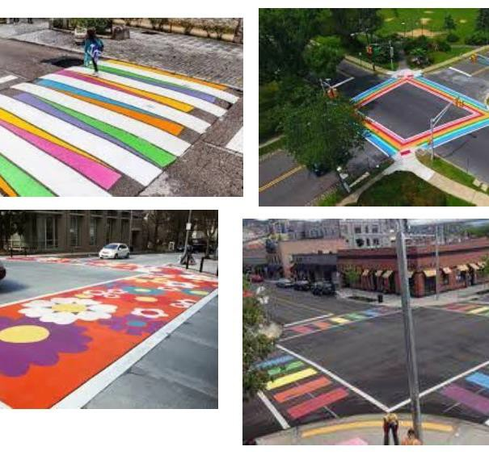
R E PA I R I N G A N D PA I N T I N G
C R O S S W A L K S
OKC will be partnering with Orchard Knob Elementary and Middle Schools on this project. The students will design and vote on the crosswalk spaces, and then they will help the neighborhood paint the crosswalks. Model crosswalk will be at the intersection of Ivy St. and 3rd Street.
Cost: $1000
Target Date: Q4 2021

Slide 37
IMPROVED STREET & GROUND LIGHTING
OKC will work with EPB on improving street lighting by replacing street lights that are out and adding additional lighting were needed. Also, we will be adding ground/path lighting as well as improving interior lights.
Target Date: Beginning October 2021

Slide 38
THANK YOU
W H I T N E Y . E V A N S S N A R D O N @ H C A H E A L T H C A R E . C O M

